Slide 1
INTELLIGENT ALERT SYSTEM FOR FOREST TRIBAL PEOPLE
Submitted by
TEAM – 19(ML Interns – 4TH May, 2020)
SRAVIKA JULOORI
SINGAM CHANDANA REDDY
RAJKAMAL GOUD VUTUKURI
BIPIN GANJI
RAHUL TEJA

Slide 2
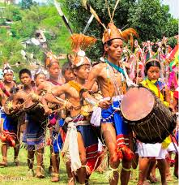
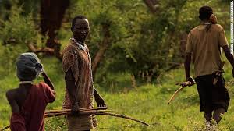
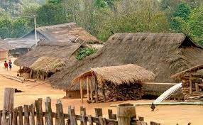
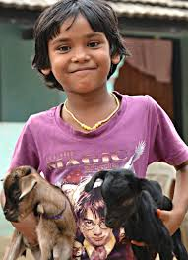
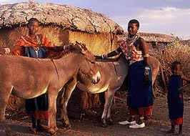
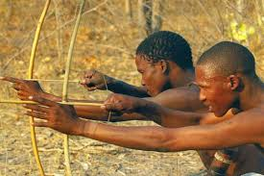
LIFE OF TRIBALS!

Slide 3
SO DO YOU THINK THEY ARE SAFE FROM WILD SPECIES ENTERING THEIR HABITATS ?
The answer would definitely
be NO!

Slide 4
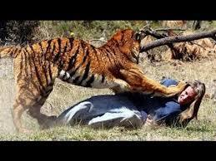
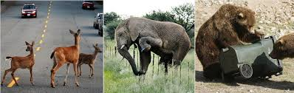
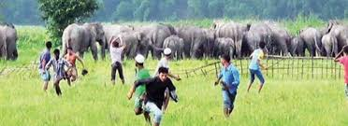
Because…
There is a high level of human–wildlife conflict
The local people would have less favourable attitudes towards problematic wild animals.
The major types of human−wildlife conflict are

Slide 5
SOLUTION!!!
Here we came up with a solution an “Intelligent Alert System”.
This Intelligent alert system for forest tribal people model is based on neural networks (CNN) incorporated with an alerting system.

Slide 6
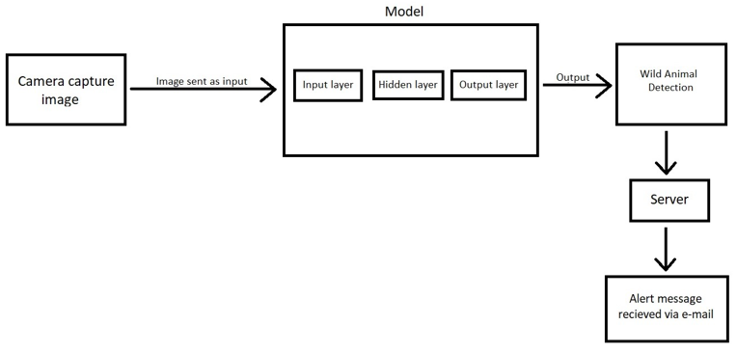
THEORITICAL ANALYSIS:
BLOCK DIAGRAM:

Slide 7
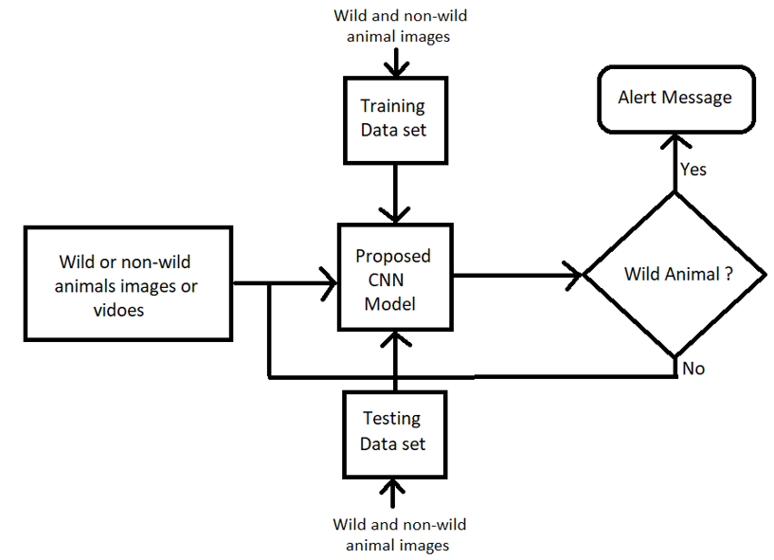
FLOWCHART:

Slide 8
ADVANTAGES & DISADVANTAGES
ADVANTAGES:
Low cost
No need for manual guarding
Can ensure
no crop raiding
no loss of domestic life due to livestock predation
decrease the risk of livestock diseases
Safeguarding human life and wildlife as well.

Slide 9
DISADVANTAGES:
Blurred detections may not work properly.
Not everyone may have facility to access mobile/device.
Limited sample size.
Disturbance effects.
Technical failures.

Slide 10
FUTURE SCOPE:
To be sure advances in hardware (high resolution cameras), storage, parallel processing architectures will enable even greater leaps in the functionality of this Intelligent Alert System thereby reducing human-wildlife conflict.
However the field of Artificial Intelligence will remains in its infancy.

Slide 11
CONCLUSION:
We conclude that the computing world has a lot to gain from neural networks as it offers more natural interaction with the real world.
Biodiversity is our life. If the Biodiversity got lost at this rate then in near future, the survival of human being will be threatened.
Hence the world needs many more applications like this with evolving technologies for human safety and to conserve biodiversity.

Slide 12
THANK YOU
FOR WATCHING!

